Slide 1
hi, thanks for stopping by.

Slide 2
welcome to buildspace x mcmaster

Slide 3
who are you guy?

Slide 4
i am
shadi el-fares.

Slide 5
started first co at 15, $28k rev by 17
avid math and physics enjoyer
school rep spoke infront of 2k ppl
currently software team @ mmrt
photographer for mdl
avid hackathon enjoyer
growing this club :0

Slide 6
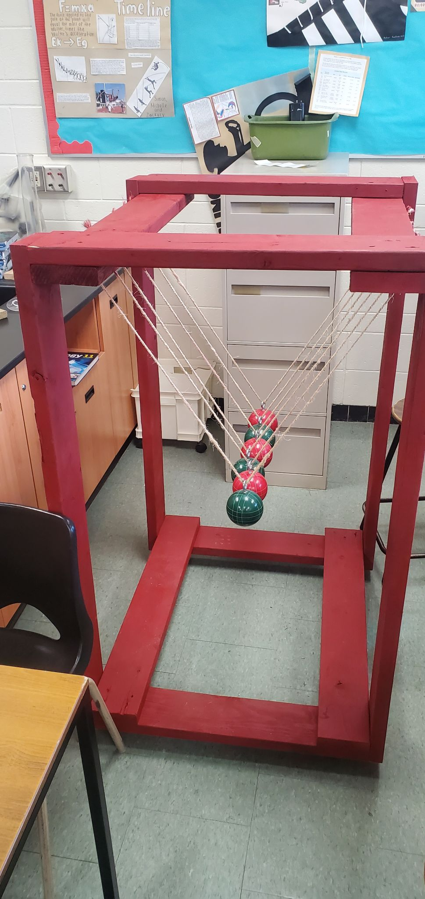
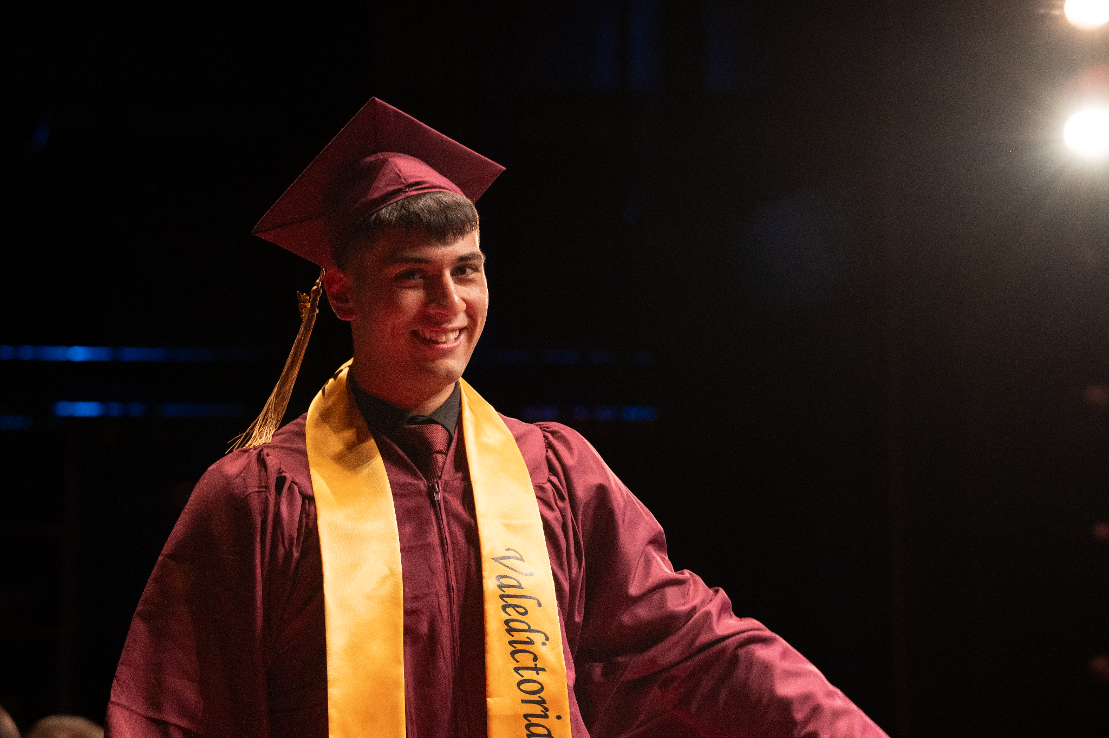
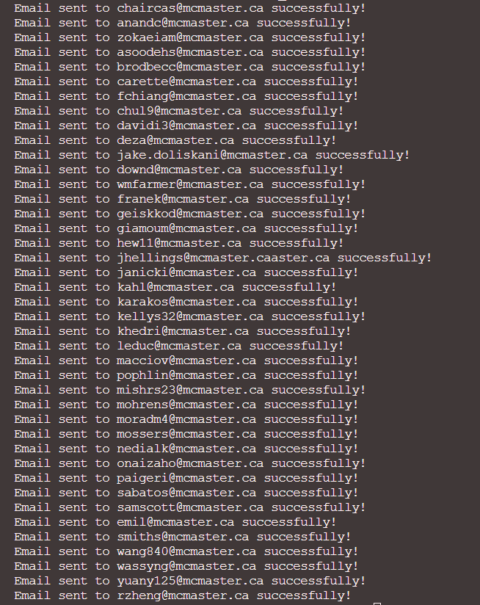
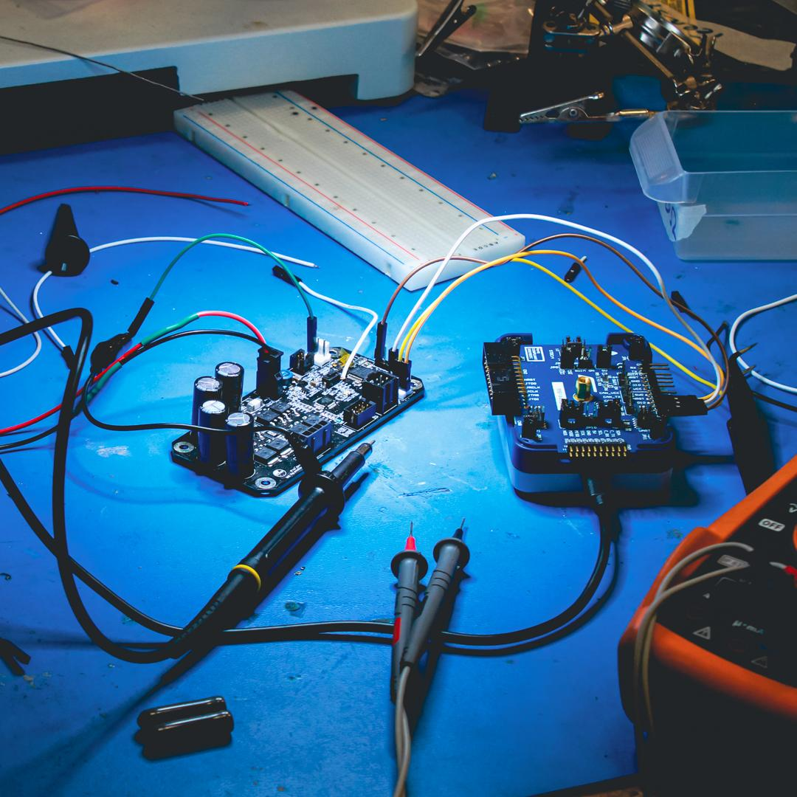
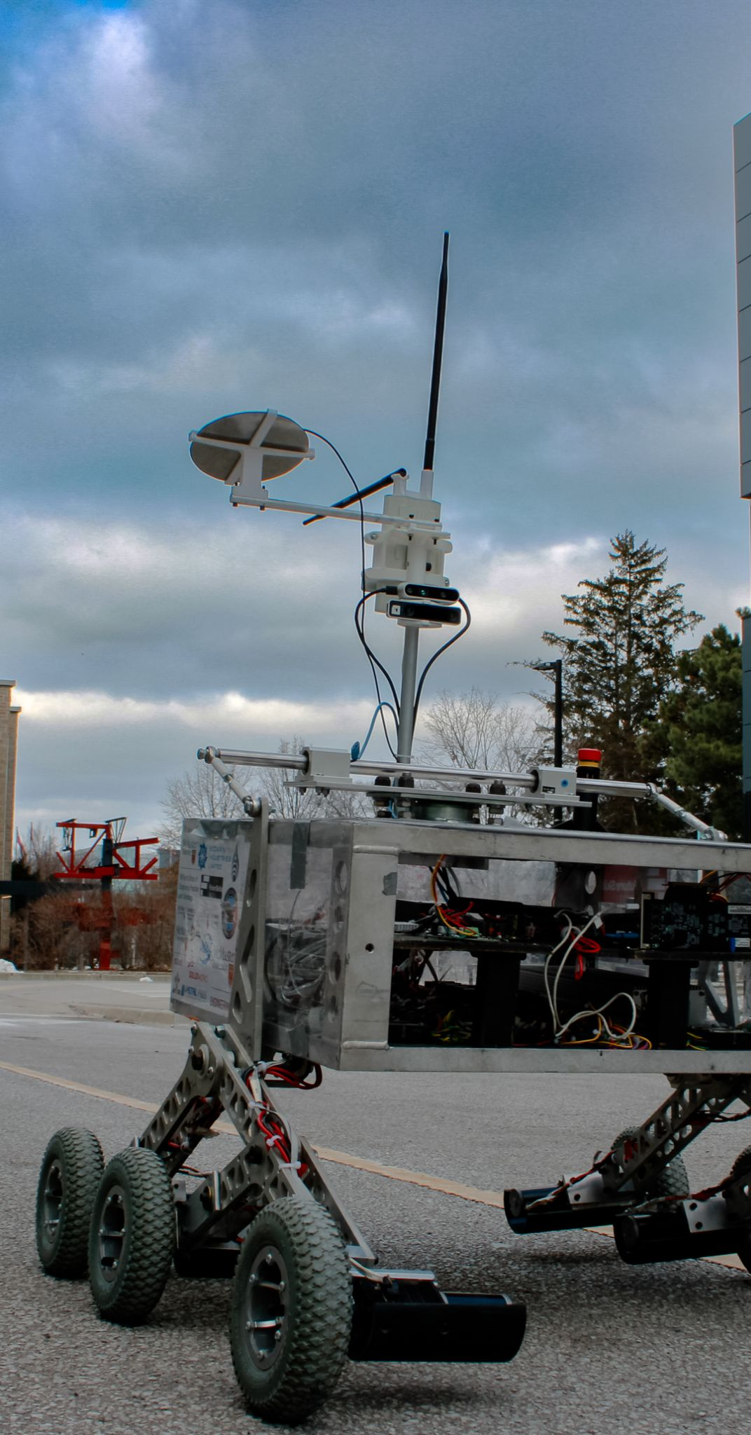
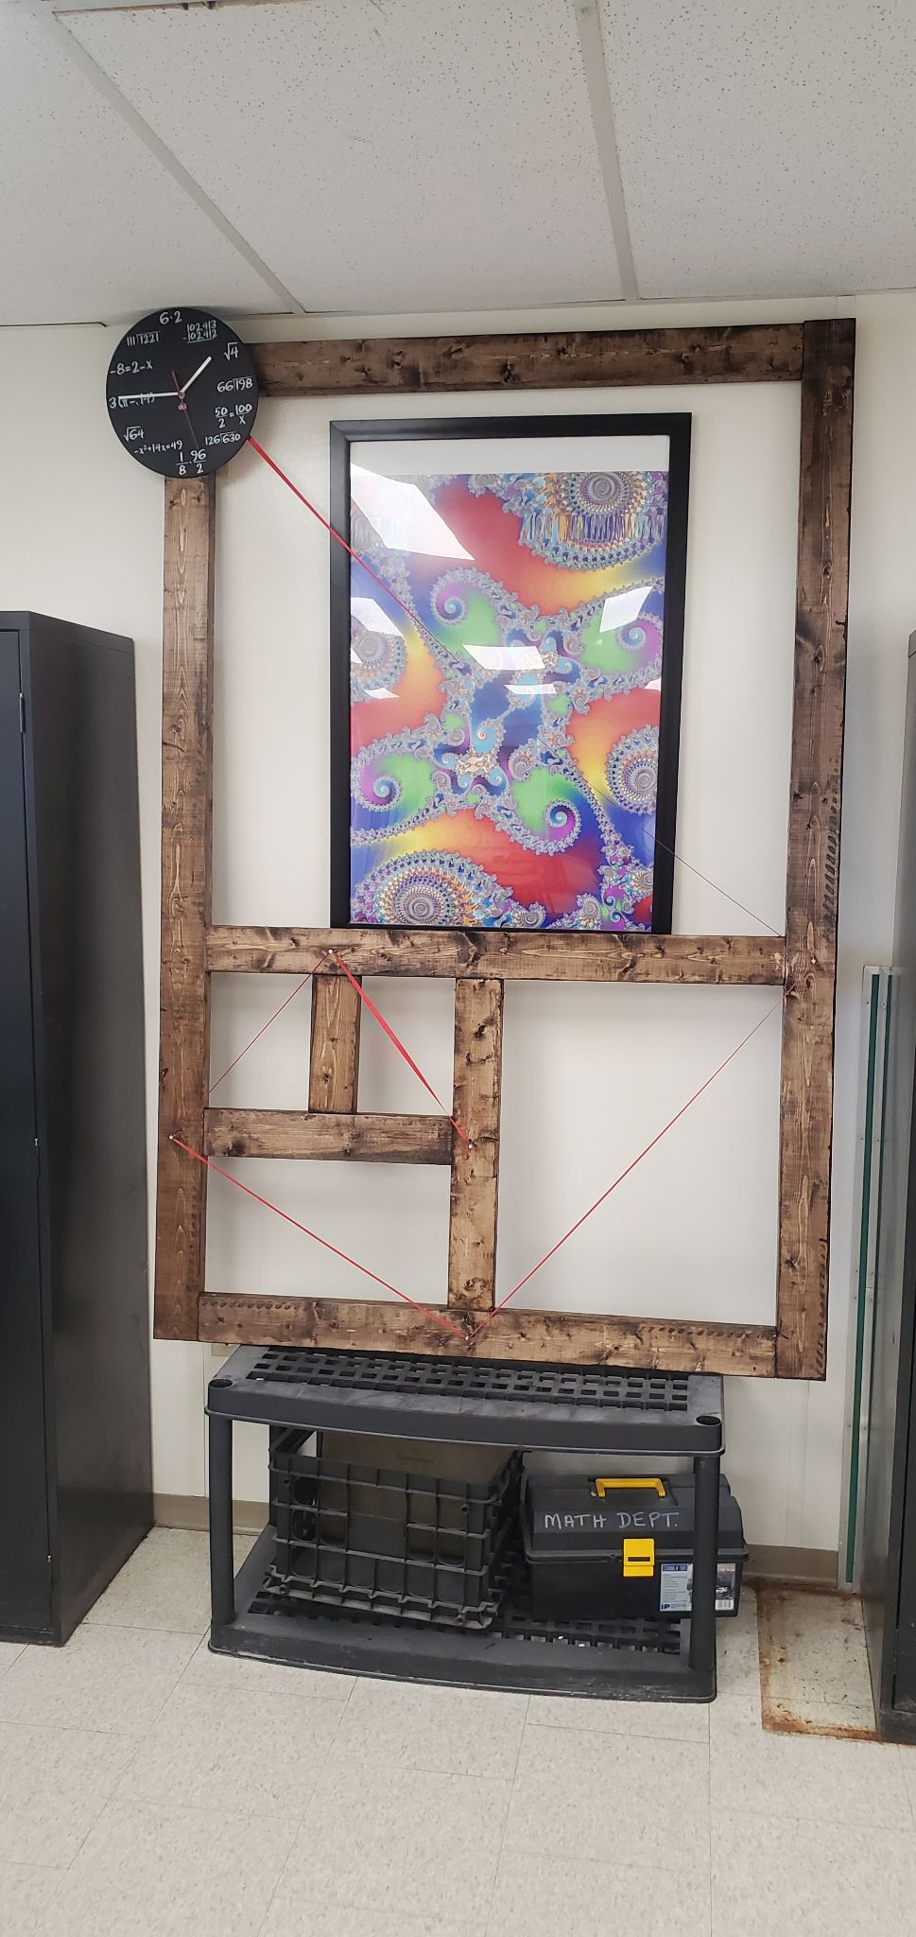
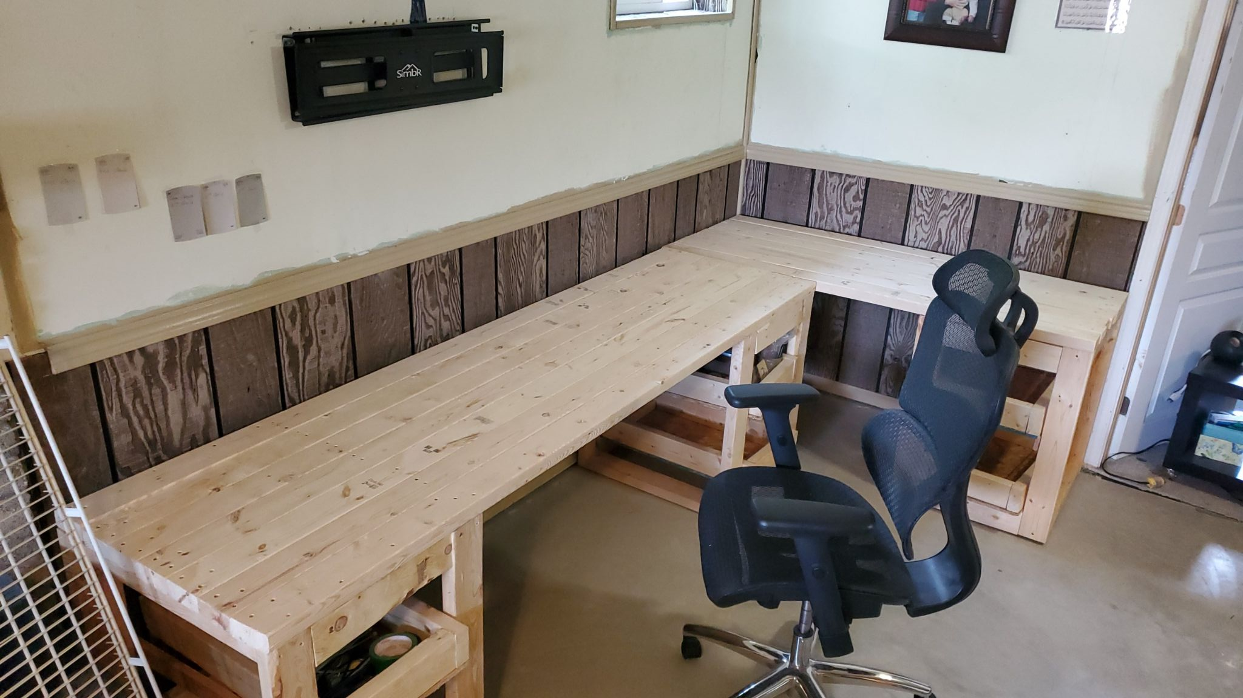
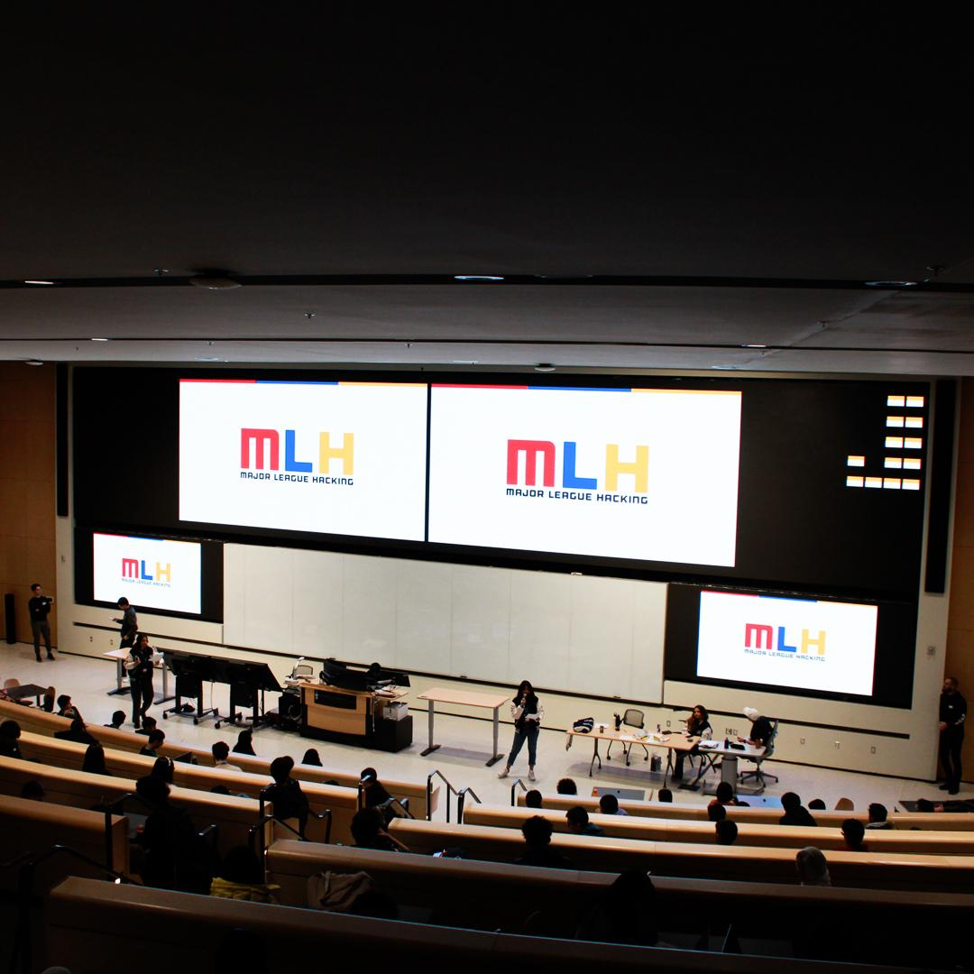
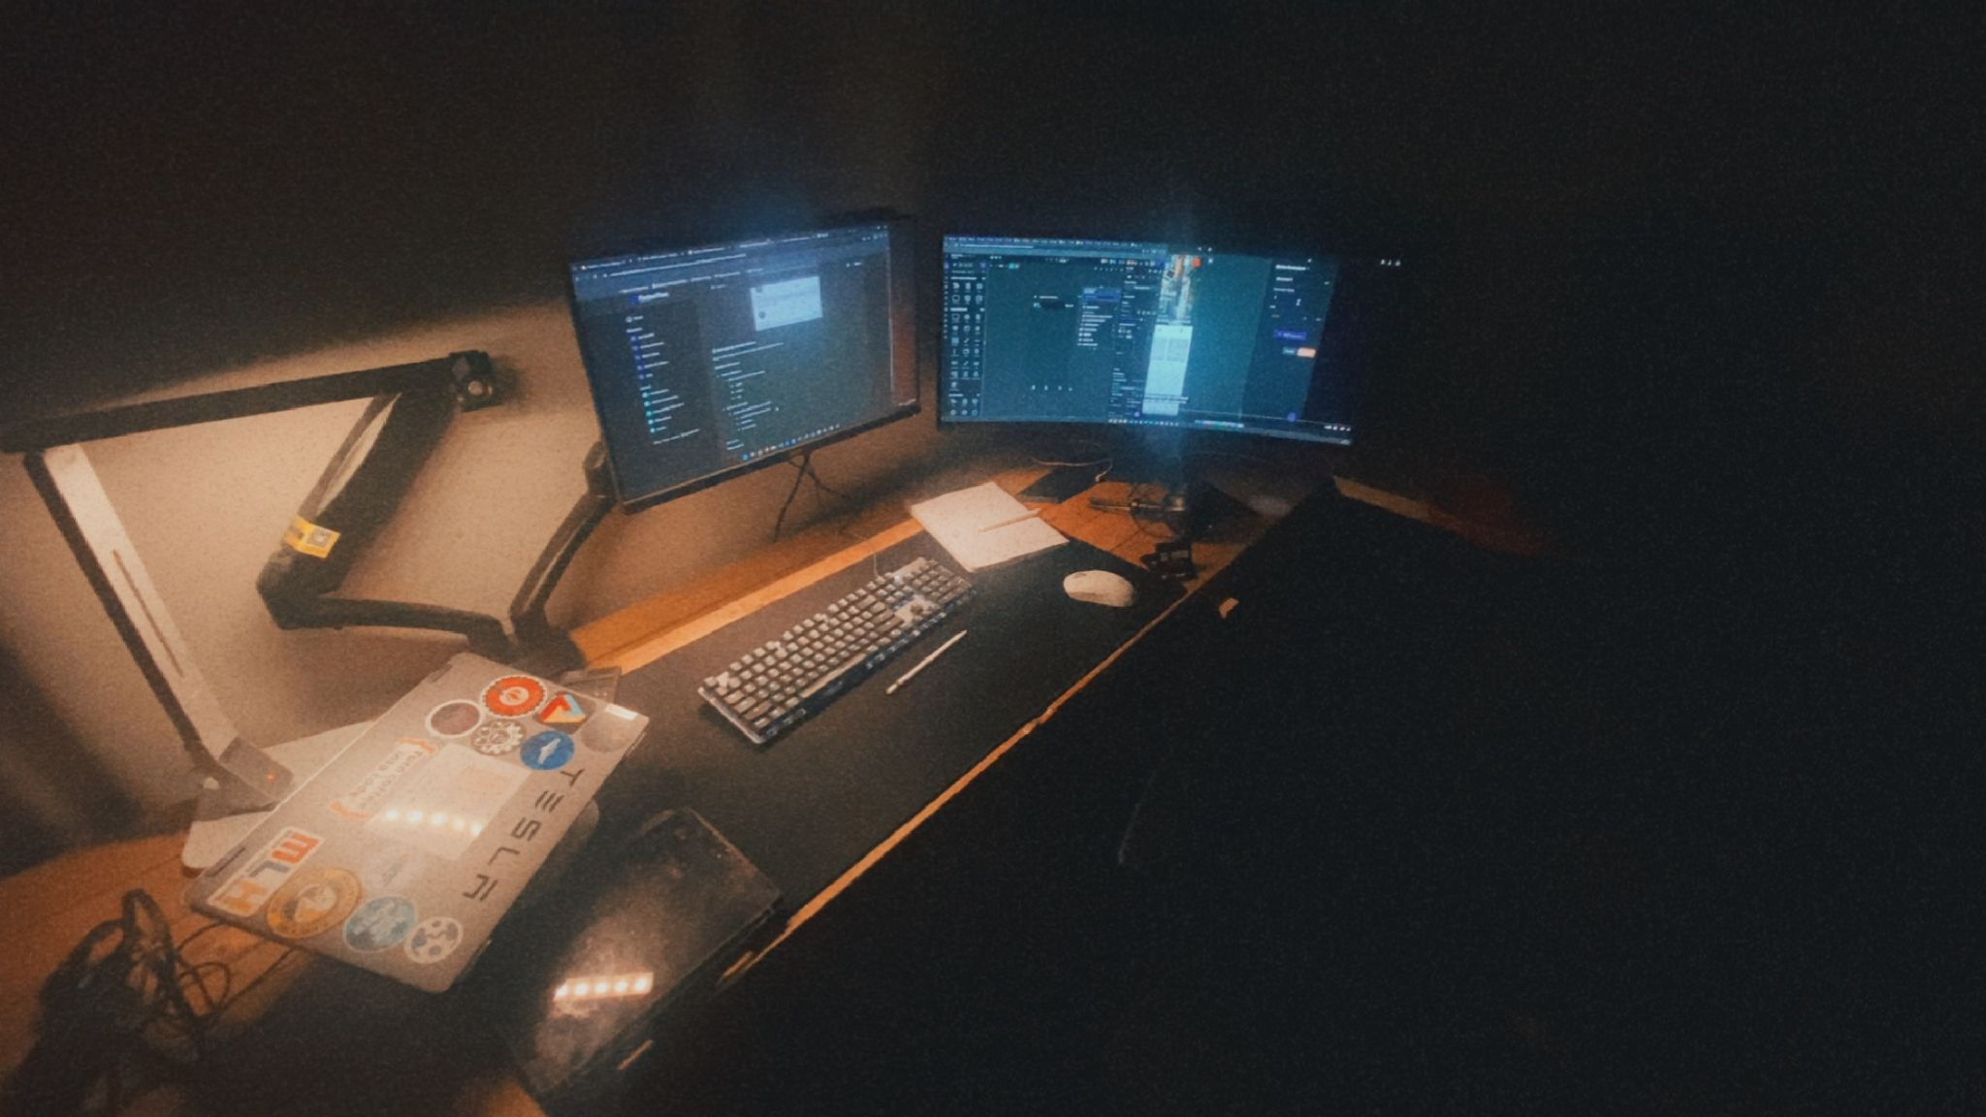
here’s some of the stuff i’ve done so far:

Slide 7
dude.
what about this club?

Slide 8
2 szns
run once per sem
w1 - idea
w2 - toy version
w3 - feedback
w4 - iterate + feedback
w5 - users + growth
w6 - demo day + final prez…

Slide 9
but shadi!
i am busy with a,b,c,d…x,y,z

Slide 10
85%

Slide 11
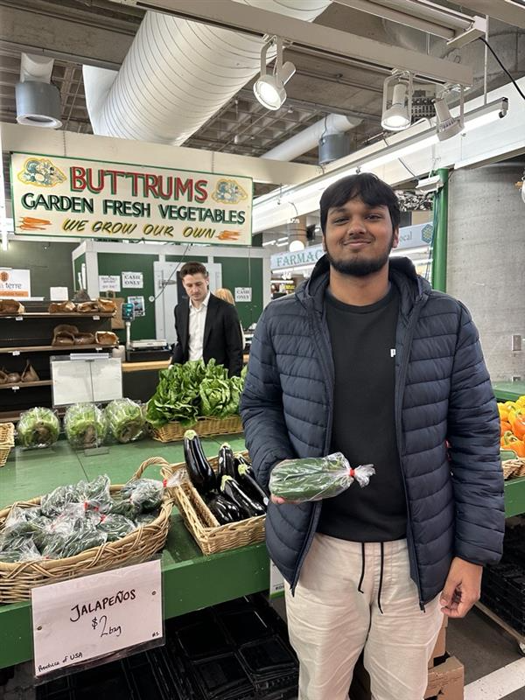
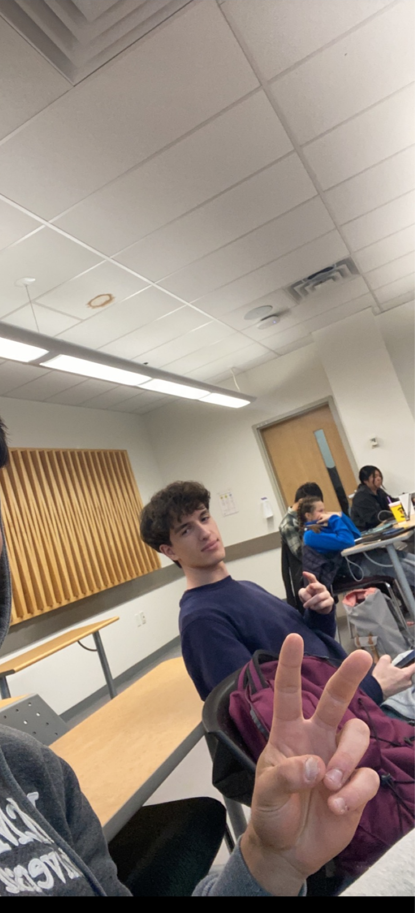
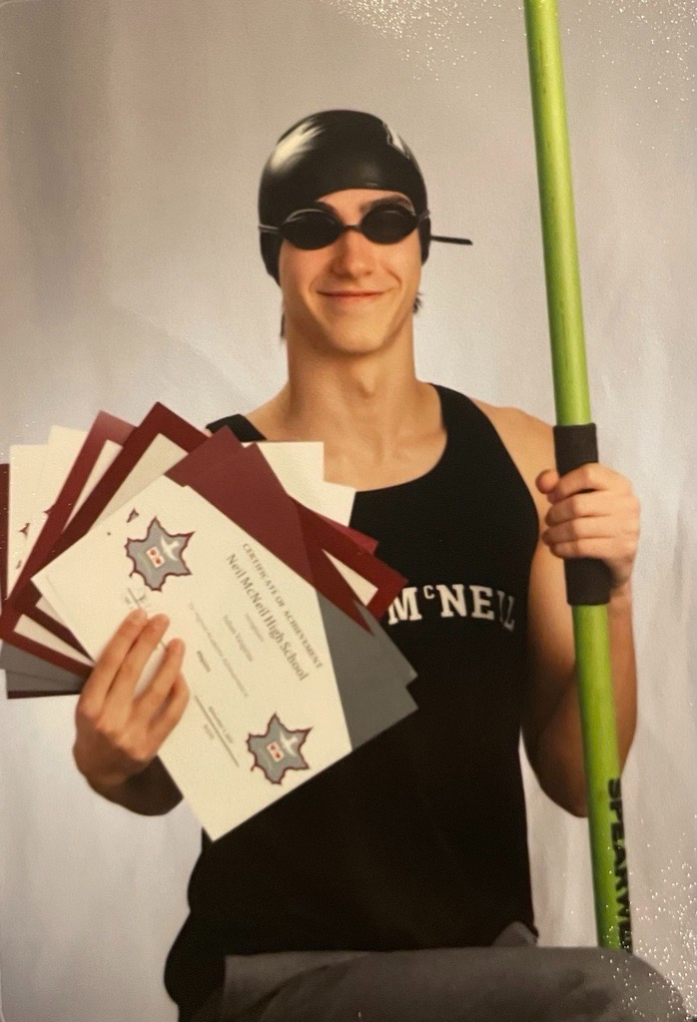
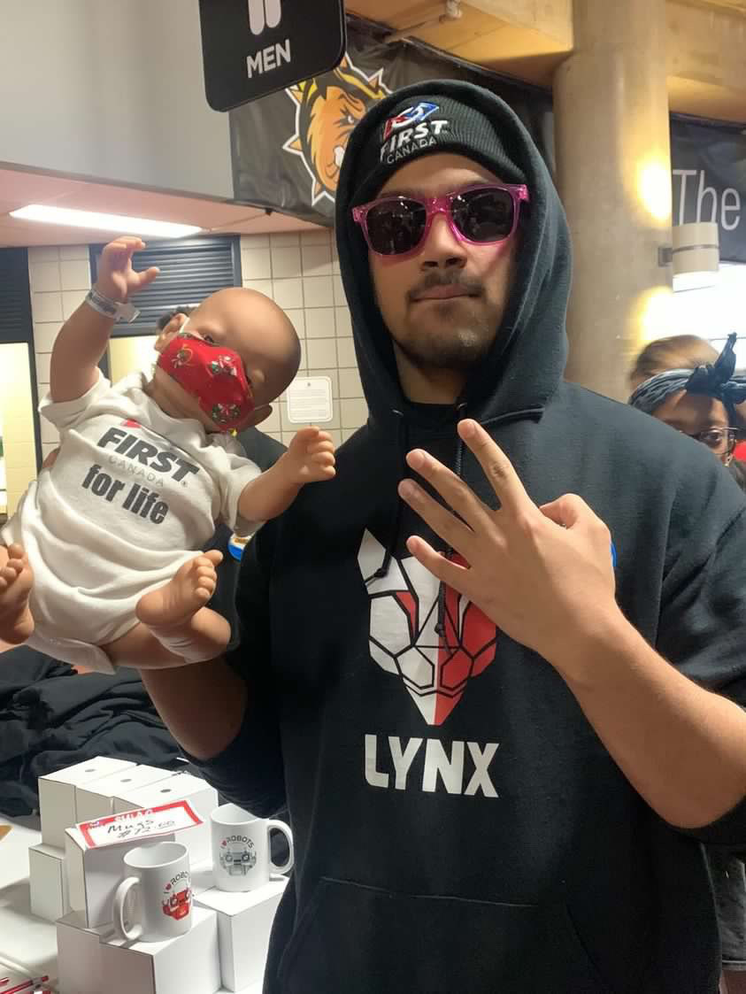
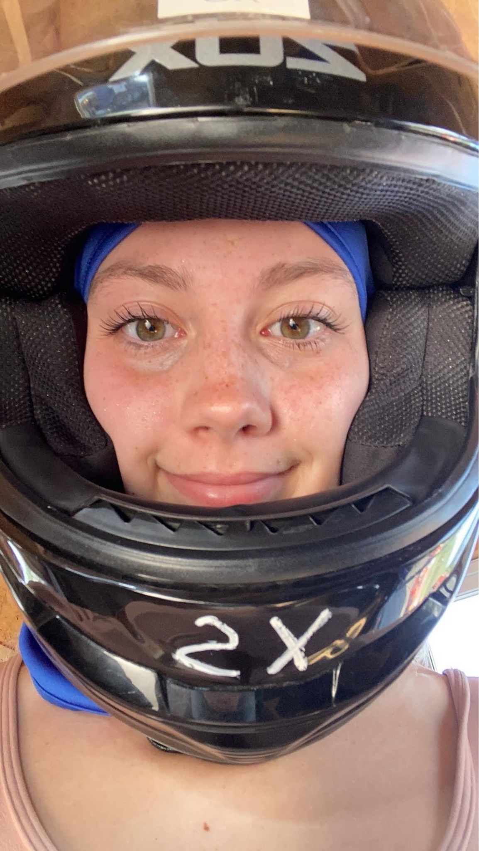
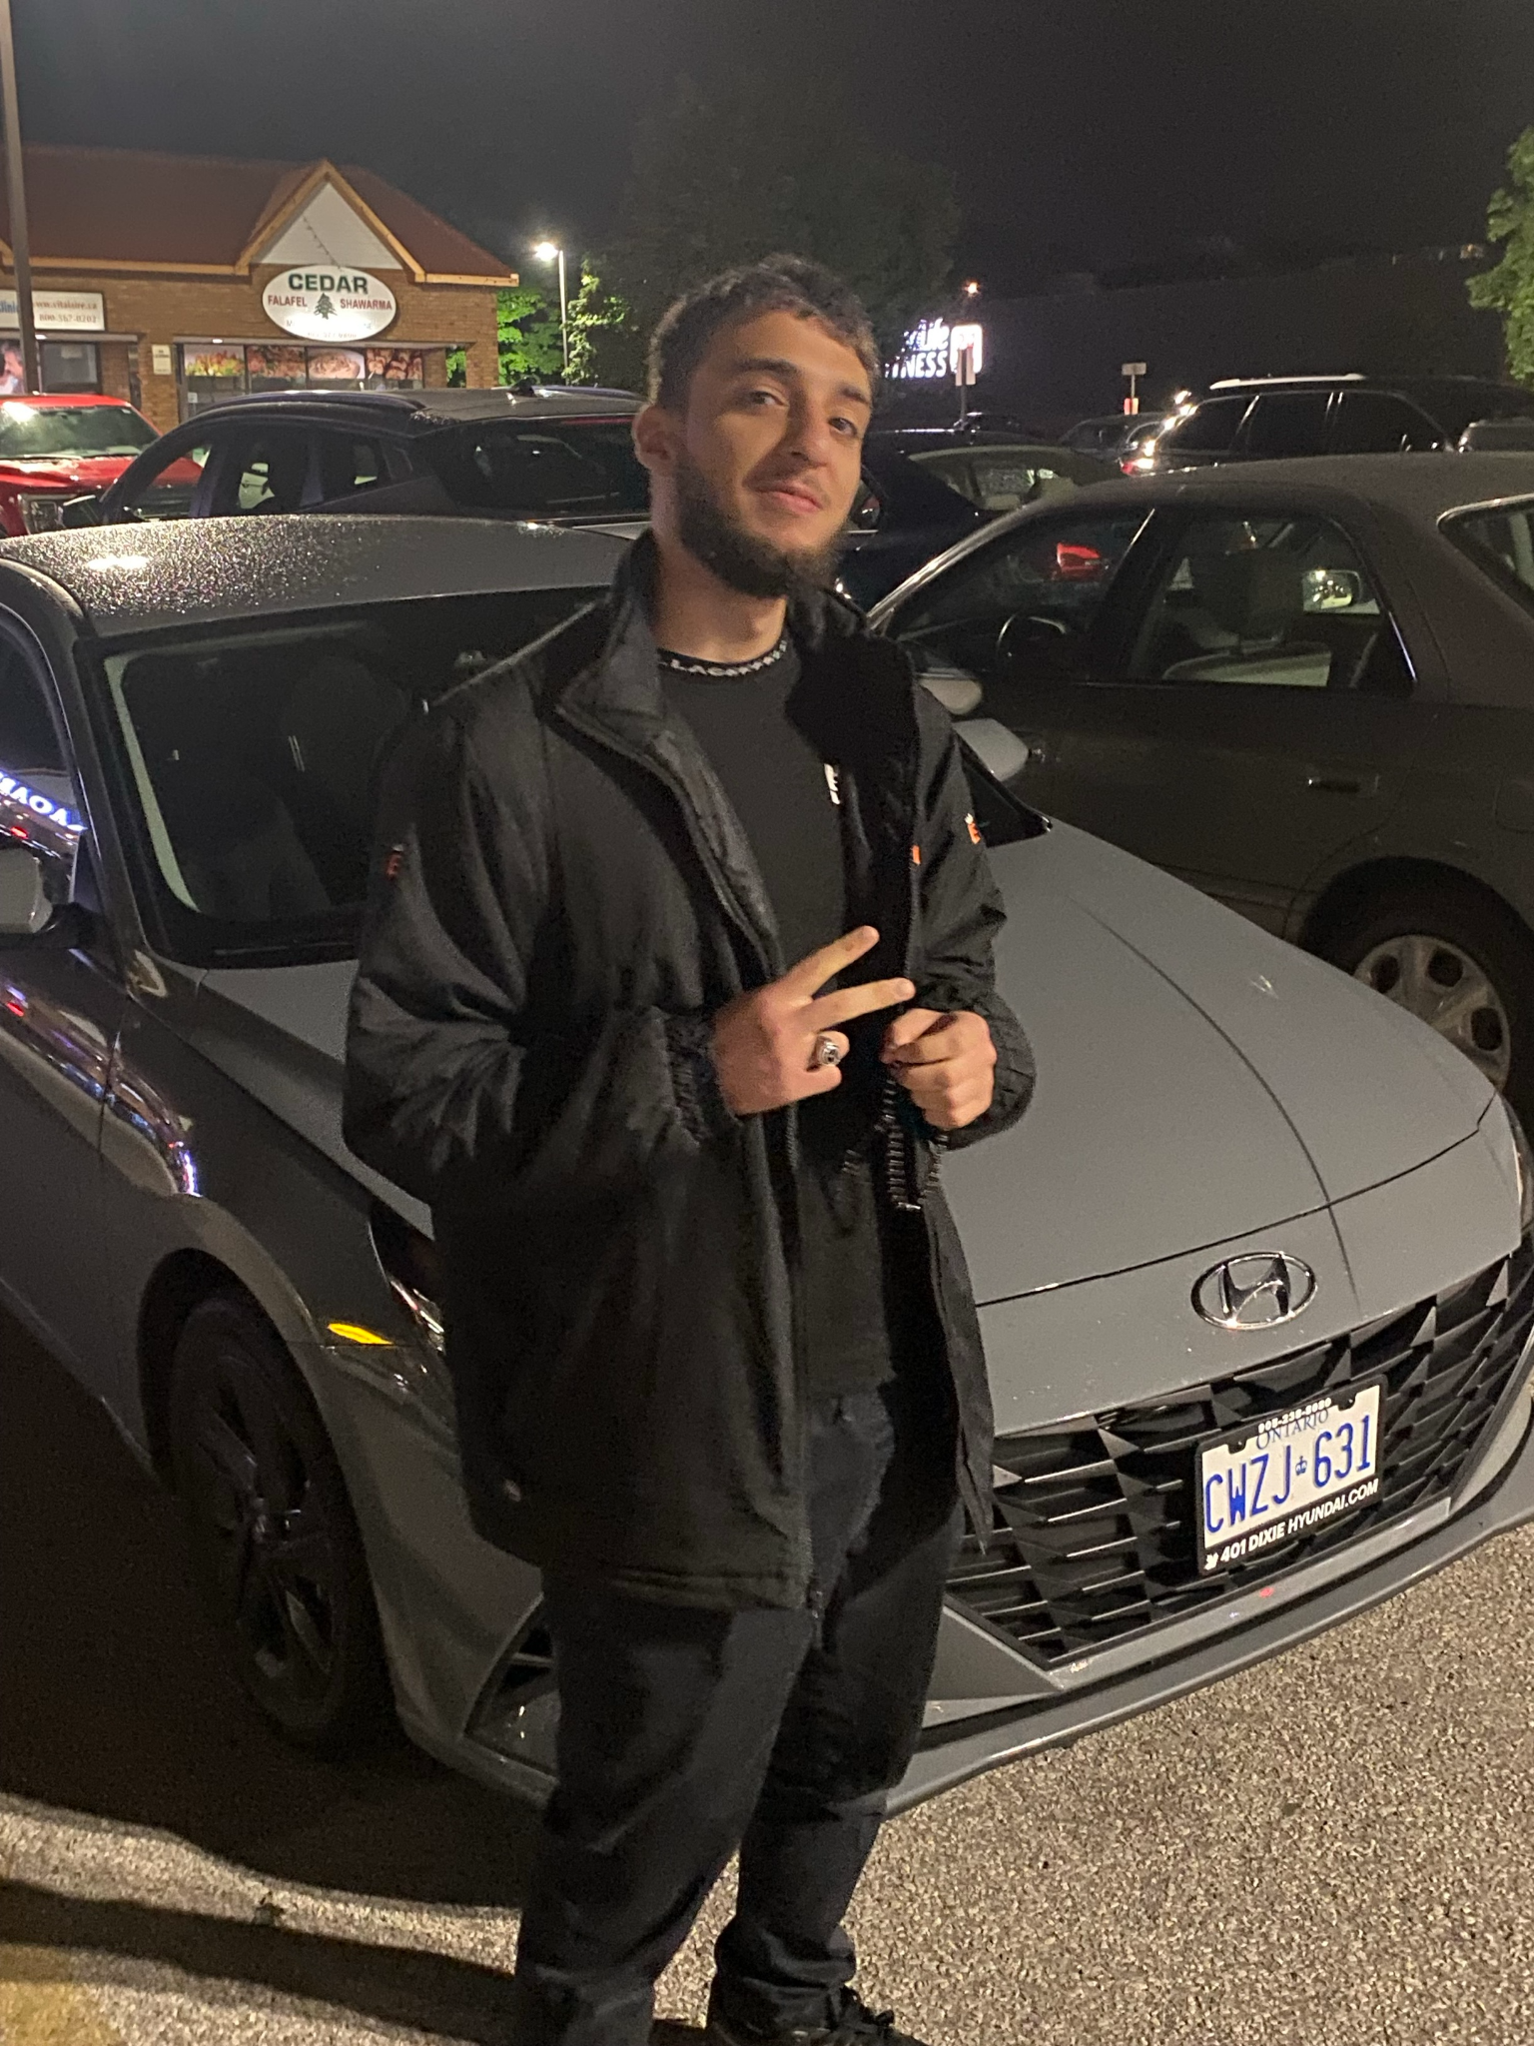
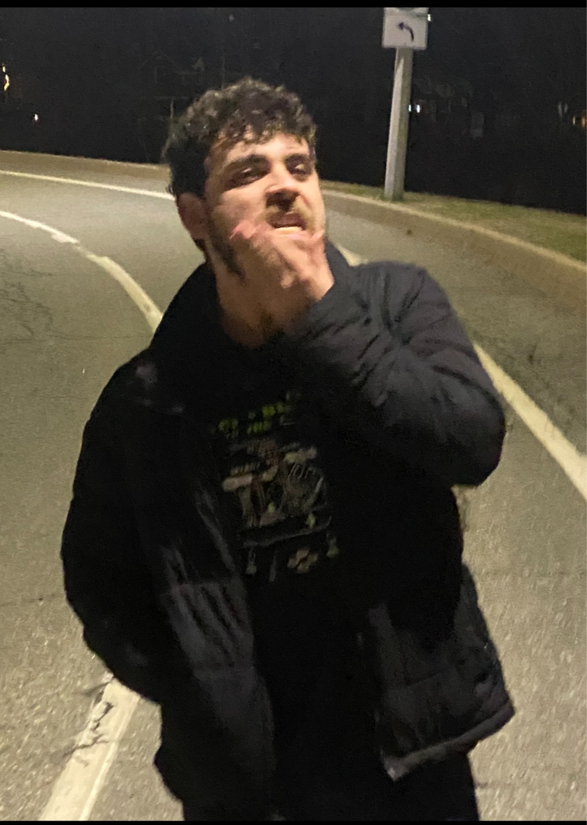
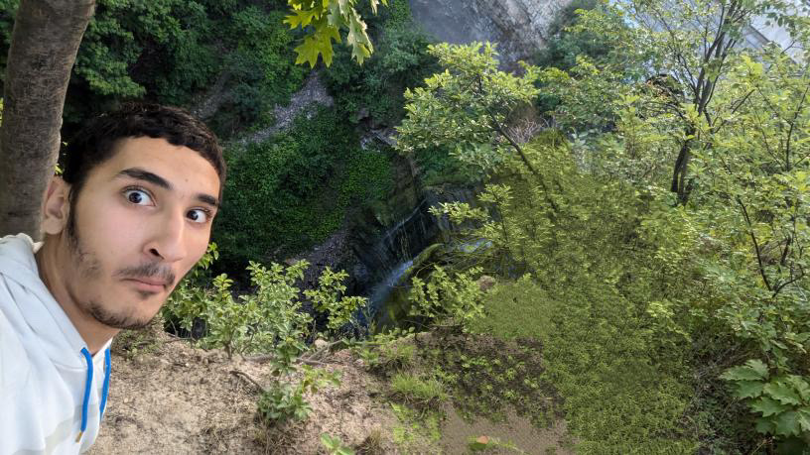
some of the amazing ppl doing this with you

Slide 12
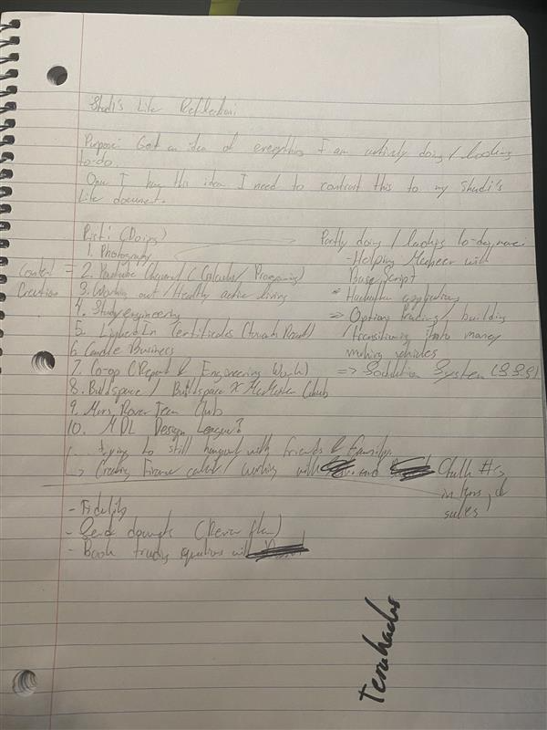
for perspective:
14 distinct activities / responsibilities.
if you love what you do, you’ll find the time to do it.

Slide 13
requirements to join:
have an idea and the willingness to work on it.

Slide 14
no idea too small, or too big.
if you’re idea has been turned away everywhere else, know you can happily develop it here :)

Slide 15
build fast, build publicly, and iterate.

Slide 16
everyone wants you to succeed, especially these peeps :)

Slide 17
really none of this existed 2 weeks ago!

Slide 18
long-term play 📝

Slide 19
so yeah, let's build some cool stuff. have fun doing it.
bring mcmaster closer together and make an impact.
i believe in us 👌

